Slide 1
String in java
Sarower Ahmmed

Slide 2
String
String is a class in JAVA
Which package in java- java.lang.String
It’s also a non primitive data type
Any character/ number/special sign → any thing can handle in string form
Lots of methods inside this String class.

Slide 3
String value cant modify but String buffer can modify
String s1 = "java";
s1.concat(" rules");// concat method will add
System.out.println("s1 refers to "+s1); // Yes, s1 still refers to "java"
StringBuffer sb = new StringBuffer("java");
sb.append(" rules");//append method will add
System.out.println(sb.toString()); //Now sb refers to "java rules"

Slide 4
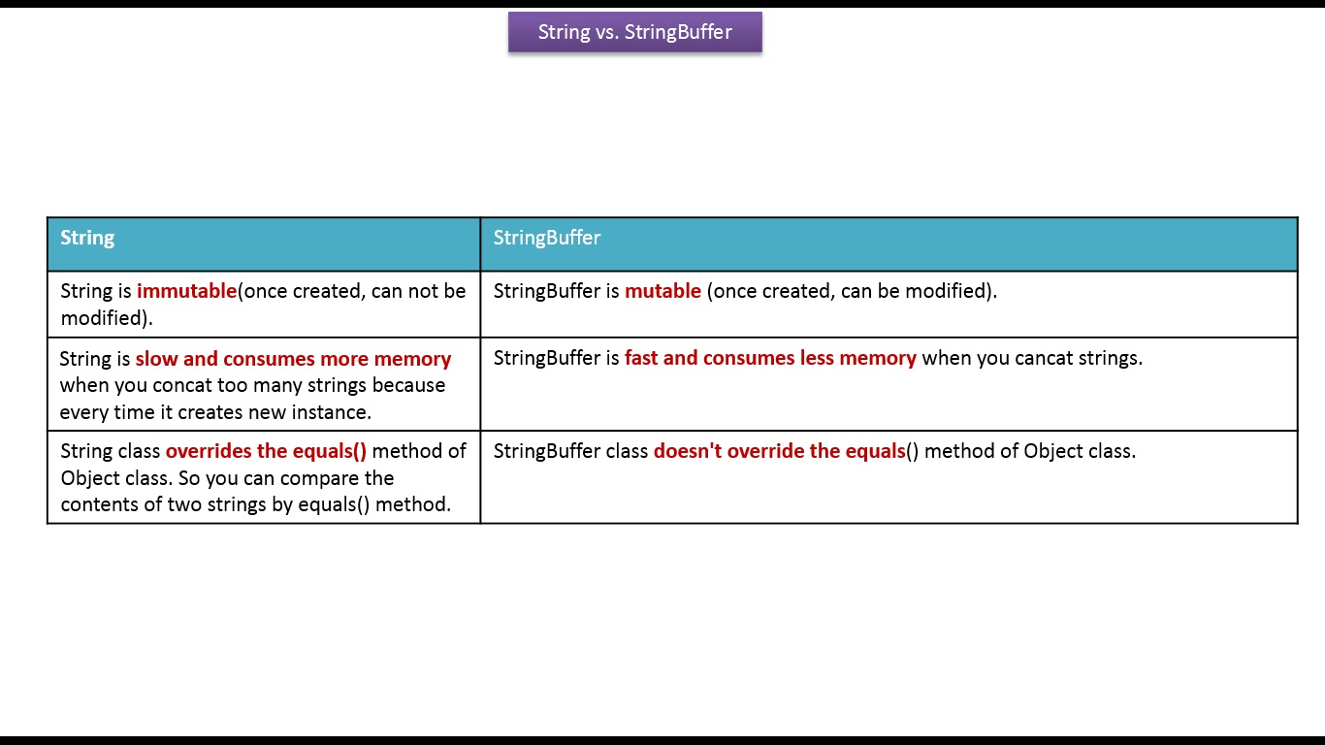

Slide 5
StringBuilder:
The StringBuilder is essentially the same as StringBuffer
But it is not thread-safe(only single thread-not possible in multi thread), that means that their methods are not synchronized.
In comparison to the other Strings, the Stringbuilder runs the fastest.
StringBuilder sb = new StringBuilder(“java");
sb.append(" rules");
System.out.println(sb.toString()); //Now sb refers to "java rules"

Slide 6
StringBuffer and StringBuilder
StringBuffer | StringBuilder
OLD Concept | New Concept
Multithread safe | Single thread safe
Synchronize | Not synchronize
Synchronized means it is thread safe and hence you can use it when you implement threads for your methods) whereas
StringBuilder is not synchronized

Slide 7
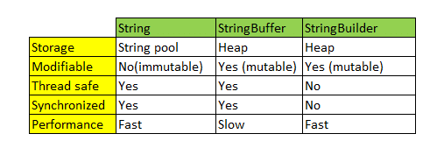
Usually
Usually
Usually

Slide 8
Performance
If you use concatenate() method of string class than String slow
Append() method is faster for StringBuffer and StringBulder
If Single thread- StringBuilder faster
If multi thread StringBuffer works better as it can synchronize

Slide 9
What is what
A thread is an independent path of execution within a program.
Multithreading refers to two or more tasks executing concurrently within a single program.
Synchronization in java is the capability to control the access of multiple threads to any shared resource.

Slide 10
How to get String class methods
Create String object/variable name
String name= “sarower”;
Name.all methods you can see
Or
String s=new String();
s.all methods

Slide 11
CompareToExample()
If you compare string with blank or empty string, it returns length of the string.
If second string is empty, result would be positive. If first string is empty, result would be negative.
String s1="hello";
String s2="";
String s3="me";
System.out.println(s1.compareTo(s2));
System.out.println(s2.compareTo(s3));
}}

Slide 12
contains() method
String name="what do you know about me";
System.out.println(name.contains("do you know"));
System.out.println(name.contains("about"));
System.out.println(name.contains("hello"));
System.out.println(name.contains(“a"));
}}
Test it Now
true
true
False
True

Slide 13
Replace() method
String a=“sarower”;
String replaceString11=a.replaceAll(“a",“e");
System.out.println(replaceString11);
String a=“sarower12345”;
String replaceString11=a.replaceAll(“[a-zA-z_0-9]"",“");
System.out.println(replaceString11);

Slide 14
Regex in java
Its called regular expression = means to find matching pattern of word from String
String inputString = "sarower";
String validPattern = "[a-zA-z_0-9]";
Pattern pattern = Pattern.compile(validPattern);
Matcher matcher = pattern.matcher(inputString);
System.out.print(matcher.find());
// should print true or false if input contain any letter

Slide 15
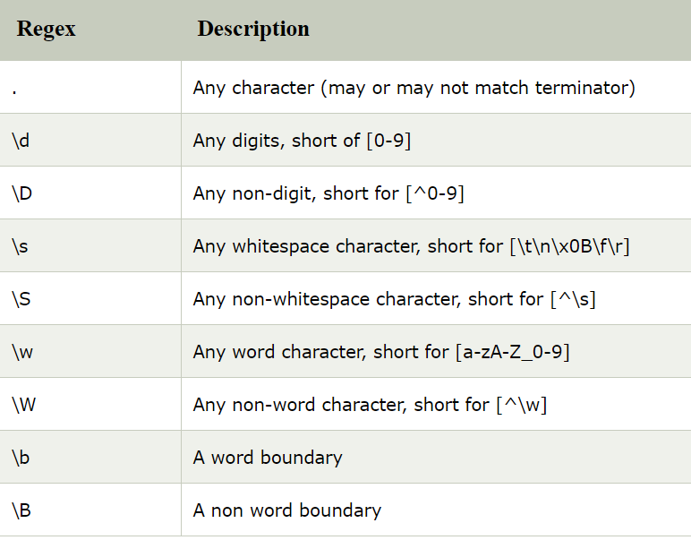

Slide 16
Convert String to int or double
String s=“12345";
int i=Integer.parseInt(s);
String s=“20.25";
double i=Double.parseInt(s);

Slide 17
How to reverse String value
String s= new String("RABO BANK");
String newobj = new StringBuffer(s).reverse().toString();
System.out.println(newobj);

